Slide 1
Data Manipulation with Pandas

Slide 2

Learning Objectives
By the end of th is le sson, you will be able to:
Explain Pandas and its features
List diffe rent data structures of Pandas
Outlin e the process to create series and Data Fram e with data inputs Exp la in how to view, se le ct, and access e lem ents in a data structure
Describe the procedure to handle vectorized operations Illu strate how to hand le m issin g va lu es
An alyze data with diffe rent data operatio n m e thods

Slide 3

Why Pandas
NumPy is great for mathematical computing, but why do we need Pandas?
Pandas with several functionalities
NumPy

Slide 4






Why Pandas
Intrinsic data alignment
Data Structures handle major
use cases
Data operation functions
Pandas
Data standardization
functions
?
Data handling functions

Slide 5





Why Pandas
Data structures handling major use cases
Pandas

Slide 6


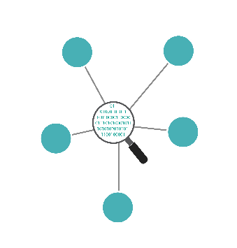


Features of Pandas
The various features of Pandas make it an efficient library for Data Scientists.
Powerful data structure
High performance merging and joining
of data sets
Fast and efficient
data wrangling
Pandas
Intelligent and automated data alignment
Easy data aggregation and transformation
Tools for reading and writing data

Slide 7
Data Structures
The four main libraries of Pandas data structure are:
One -dim ensio nal la be le d array
Supports m ultip le data types
Series
Two -dim ensio nal la be le d array
Supports m ultip le data types
Inp ut can be a series
In put can be another Data Fram e
Data Fram e
Three -dim ensio nal la be le d array
Supports m ultip le data types
Ite m s □ axis 0
Ma jo r axis □ rows
Minor axis□ colum ns
Panel
Four -dim ensio nal la be le d array
Supports m ultip le data types
La bels □ axis 0
Ite m s □ axis 1
Ma jo r axis □ rows
Minor axis□ colum ns
Panel 4D (Exp erim ental)

Slide 8

Understanding Series
Series is a one-dimensional array -like object containing data and labels (or index).
Data
 | 4 |  | 11 | 21 | 36
 |  | 0 | 1 | 2 | 3
Label(index)
Data alignment is intrinsic and will not be broken until changed explicitly by program.

Slide 9
Series
Series can be created with different data inputs:
Data Input
In teger
Strin g
Python Ob je ct
Flo a tin g Po in t
ndarray
d ict
sca lar
lis t
 | 2 | 3 | 8 | 4
 | 0 | 1 | 2 | 3
La bel(index)
Data Types
Series

Slide 10
How to Create Series?
Key points to note while creating a series are:
Im port Pandas as it is the m ain library (Im port pandas as pd)
Im port Num Py wh ile working with ndarrays (Im port num py as np)
Ap ply the syntax and pass the data e lem ents as argum ents
Basic Method
S = pd.Series(data, index = [index])
4 | 11 | 21 | 36
Series

Slide 11
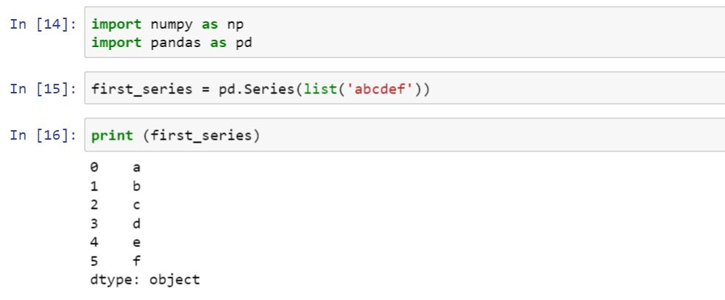
Creating Series from a List
Import libraries
Pass list as an argument
Data value
Index
Data type
We have not created index for data but notice that data alignment is done automatically.

Slide 12

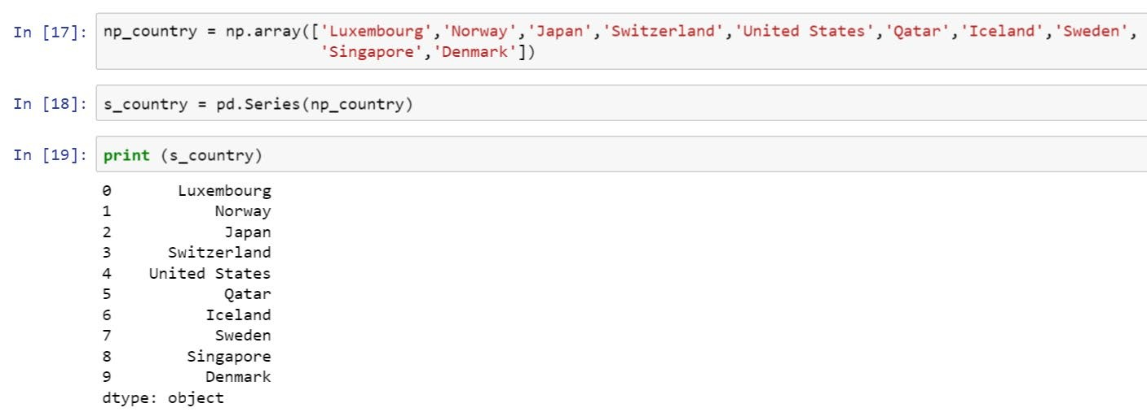
Creating Series from an ndarray
ndarray for countries
Pass ndarray as an argument
countrie s
Data type

Slide 13
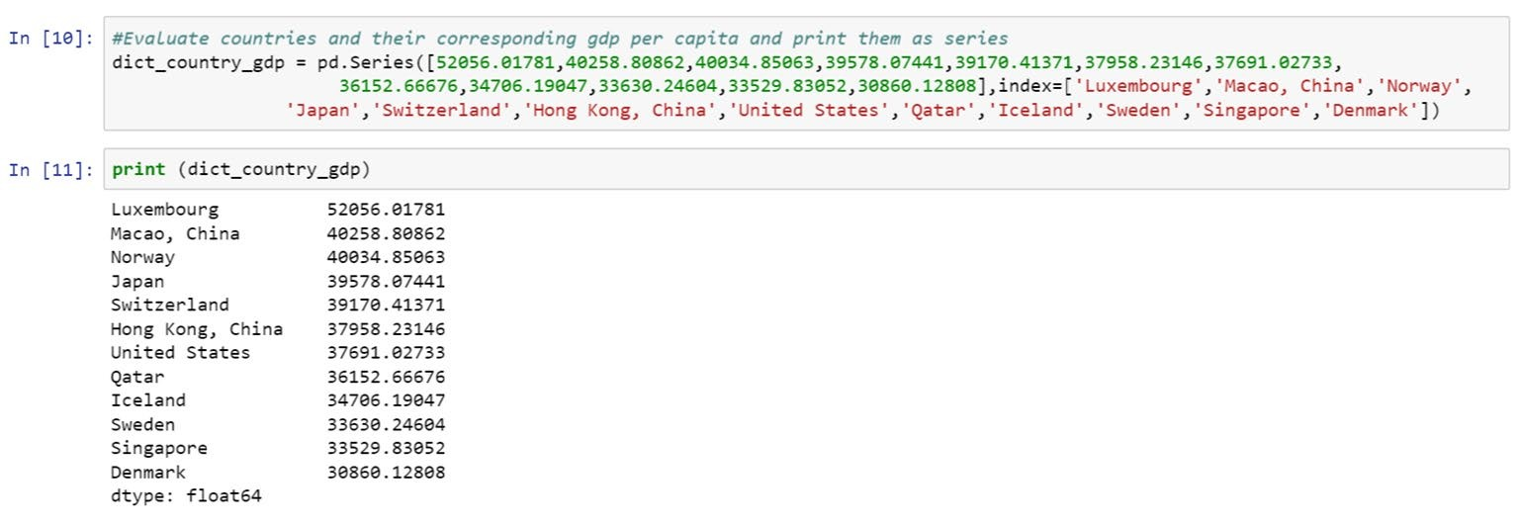
Creating Series from dict
A series can also be created with dict data input for faster operations.
dict for countries and their gdp
Countries have been passed as an index and GDP as the actual data value
GDP
Country
Data type

Slide 14
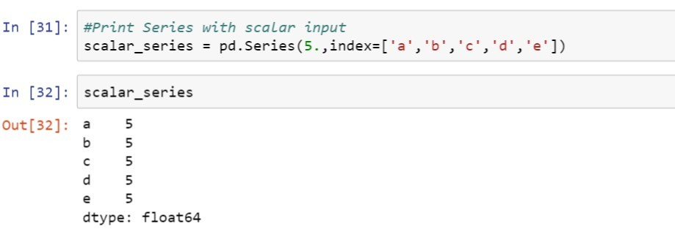



Creating Series from Scalar
Scalar input
Index
Data
index
Data type

Slide 15
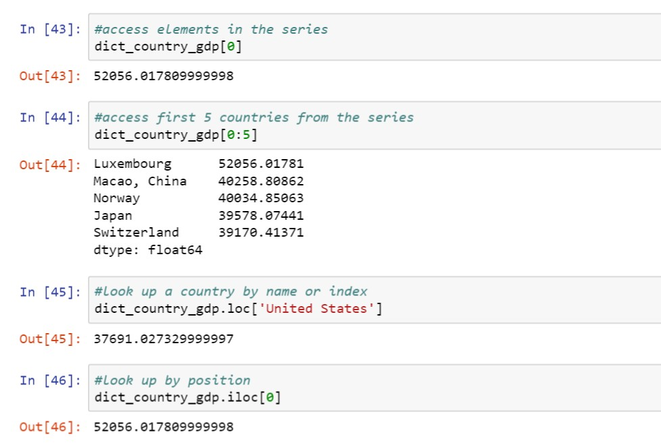
Accessing Elements in Series
Data can be accessed through different functions like loc, iloc by passing data element position or index range.

Slide 16
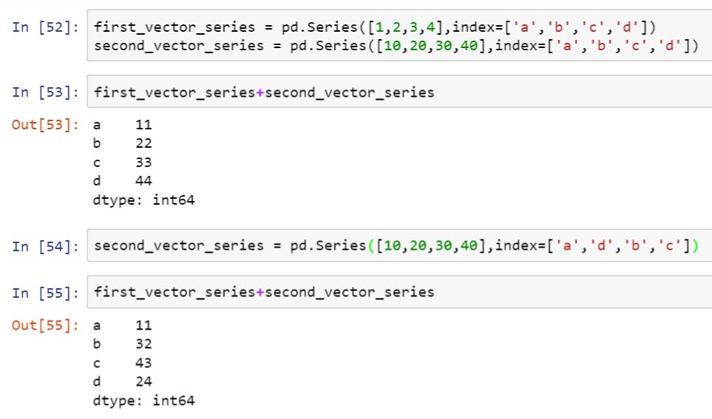
Vectorizing Operations in Series
Vectorized operations are performed by the data element’s position.
Add the series

Slide 17
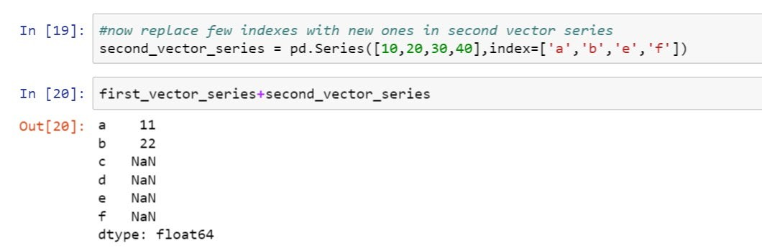
Vectorizing Operations in Series

Slide 18
Data Frame
DataFrame is a two -dimensional labeled data structure with columns of potentially different types.
Data Input
In teger
Strin g
Python Ob je ct
Flo a tin g Po in t
ndarray
d ict
Lis t
Series
Data Fram e
 | 2 |  | 3 | 8 | 4
 | 5 |  | 8 | 10 | 1
 |  | 0 | 1 | 2 | 3
La bel(index)
Data Types
DataFrame

Slide 19
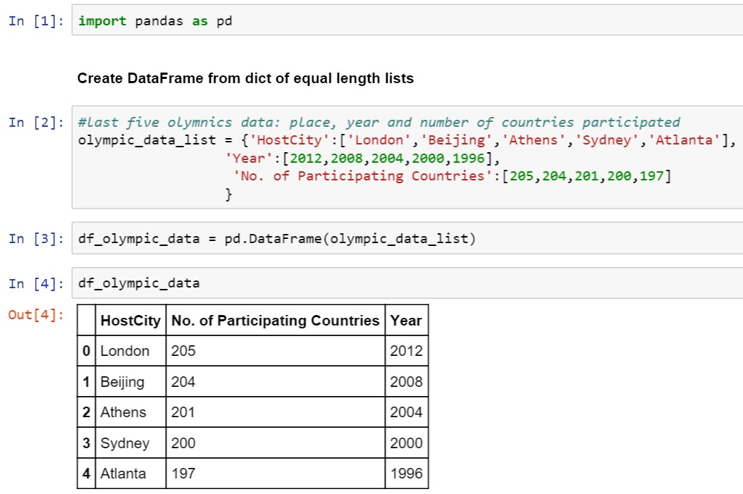
Creating DataFrame from Lists
Pass the list to the DataFrame

Slide 20
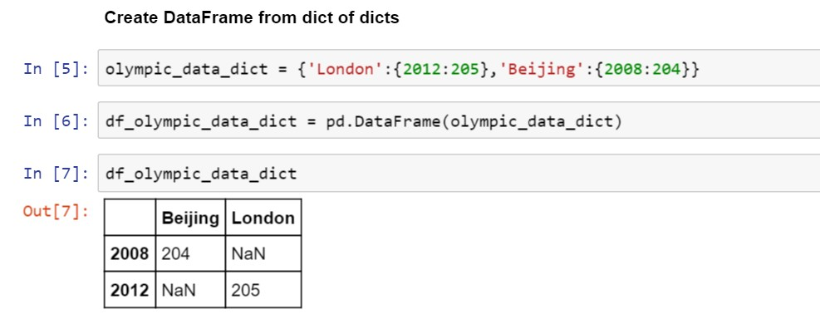

Creating DataFrame from dict
This example shows you how to create a DataFrame from a series of dicts.
dict one
dict two
Entire dict

Slide 21
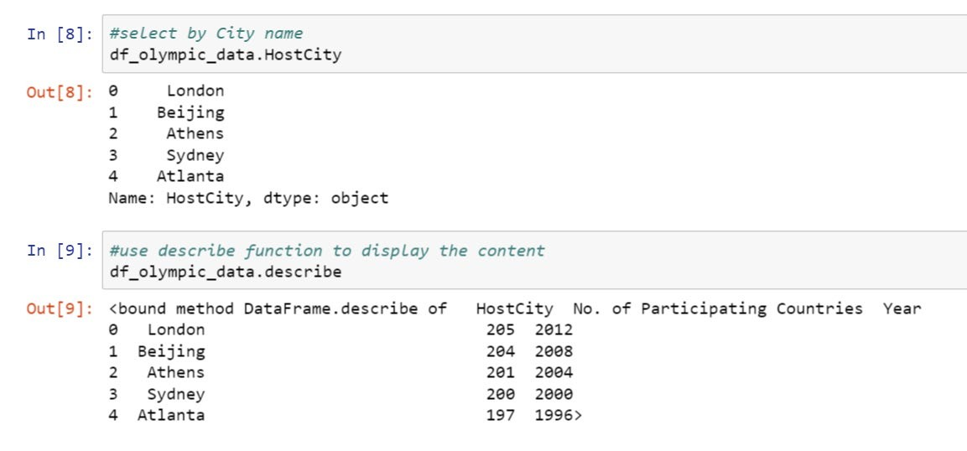
Viewing DataFrame
You can view a DataFrame by referring to the column name or with the describe function.

Slide 22
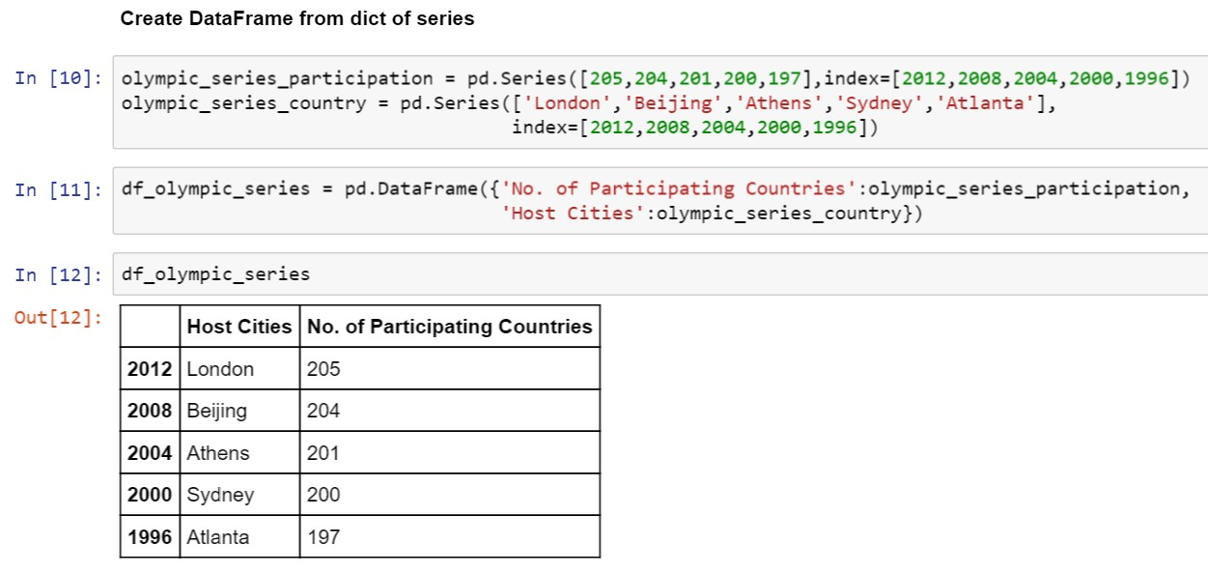
Creating DataFrame from dict of Series

Slide 23
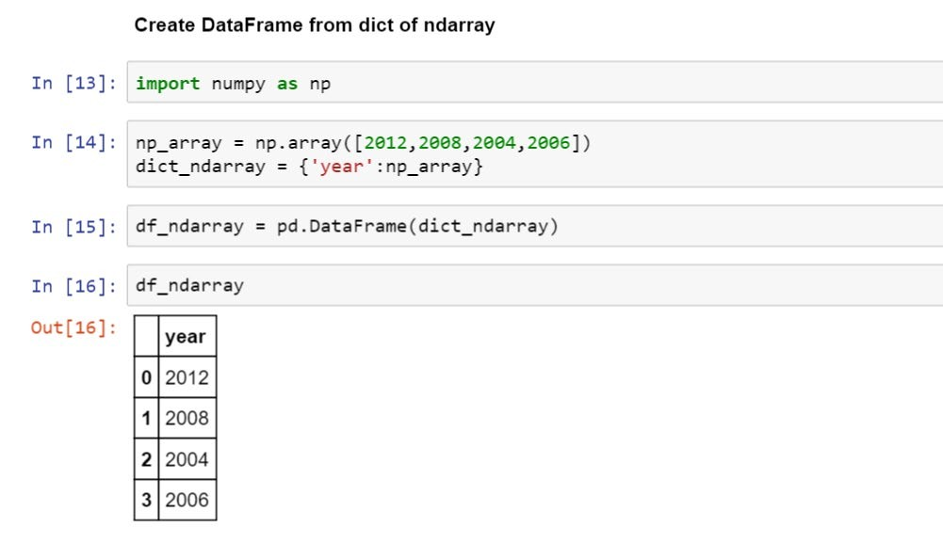
Creating DataFrame from ndarray
Create a ndarray with years Create a dict with the ndarray
Pass this dict to a new DataFrame

Slide 24
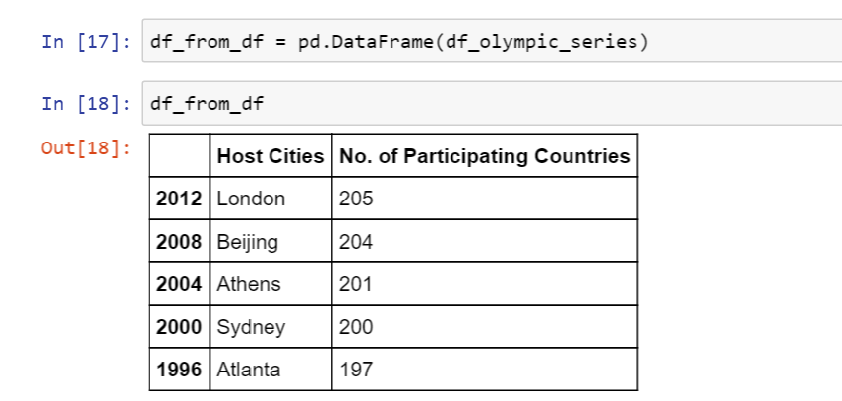
Creating DataFrame from DataFrame Object
Create a DataFrame from a DataFrame object

Slide 25
View and Select Data
Problem Statement: Demonstrate how to view and select data in a DataFrame
Access: Click on the Practice Labs tab on the left side panel of the LMS. Copy or note the username and password that is generated. Click on the Launch Lab button. On the page that appears, enter the username and password in the respective fields, and click Login .

Slide 26








Missing Values
Various factors may lead to missing data values:
Data not provided by the
source
Software issue
Data integration issue
Network issue

Slide 27
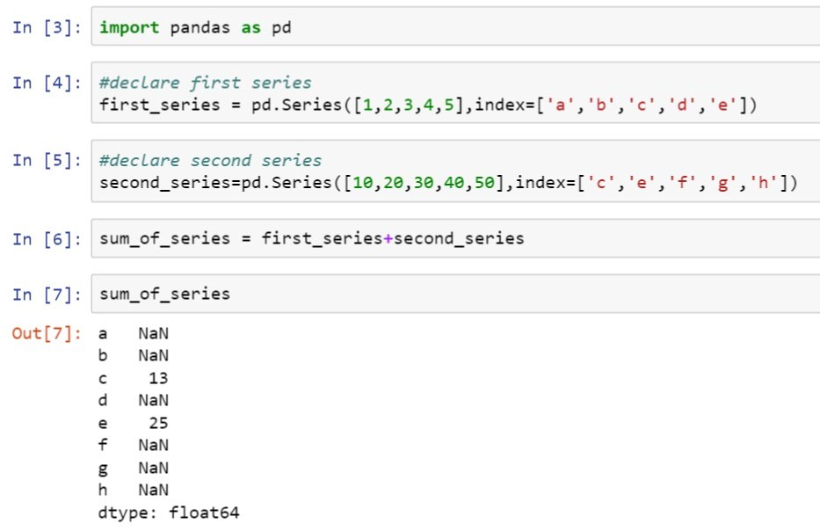
Handling Missing Values
It’s difficult to operate a dataset when it has missing values or uncommon indices.

Slide 28
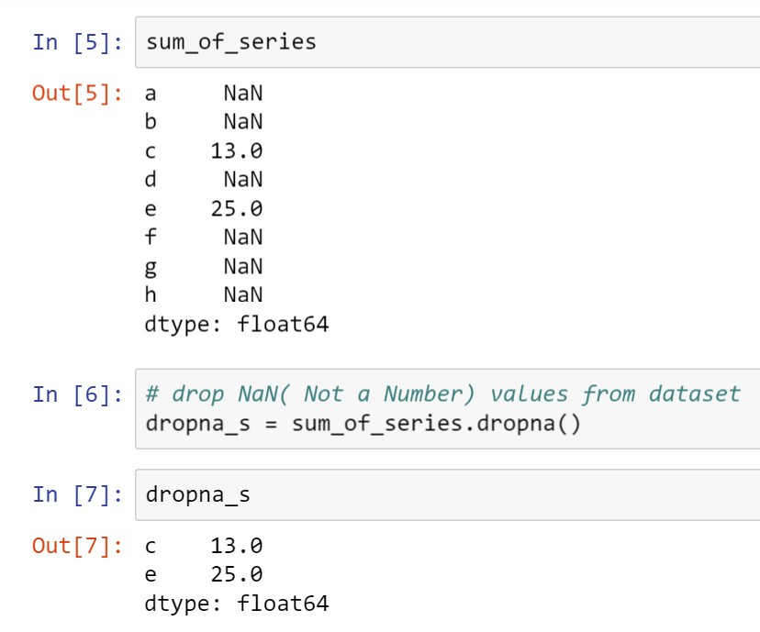
Handling Missing Values with Functions
The dropna function drops all the values with uncommon indices.

Slide 29
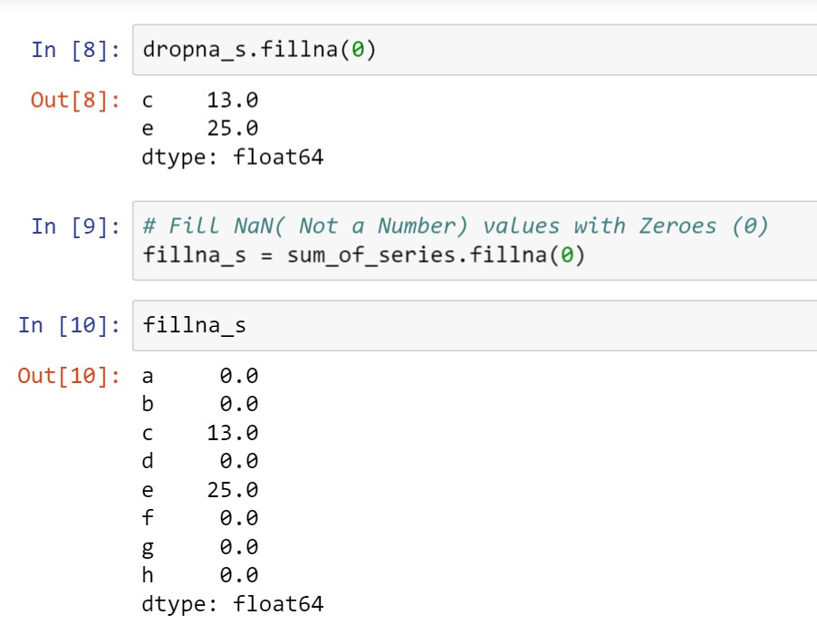
Handling Missing Values with Functions
The fillna function fills all the uncommon indices with a number instead of dropping them.
Fill the missing values with zero

Slide 30
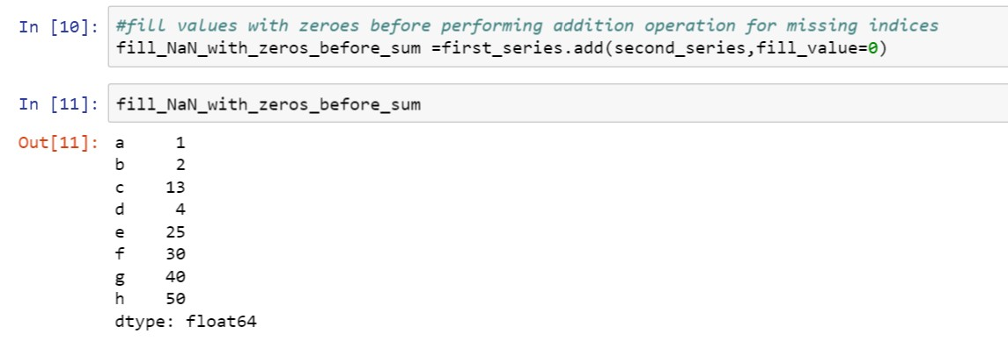
Handling Missing Values with Functions: Example

Slide 31
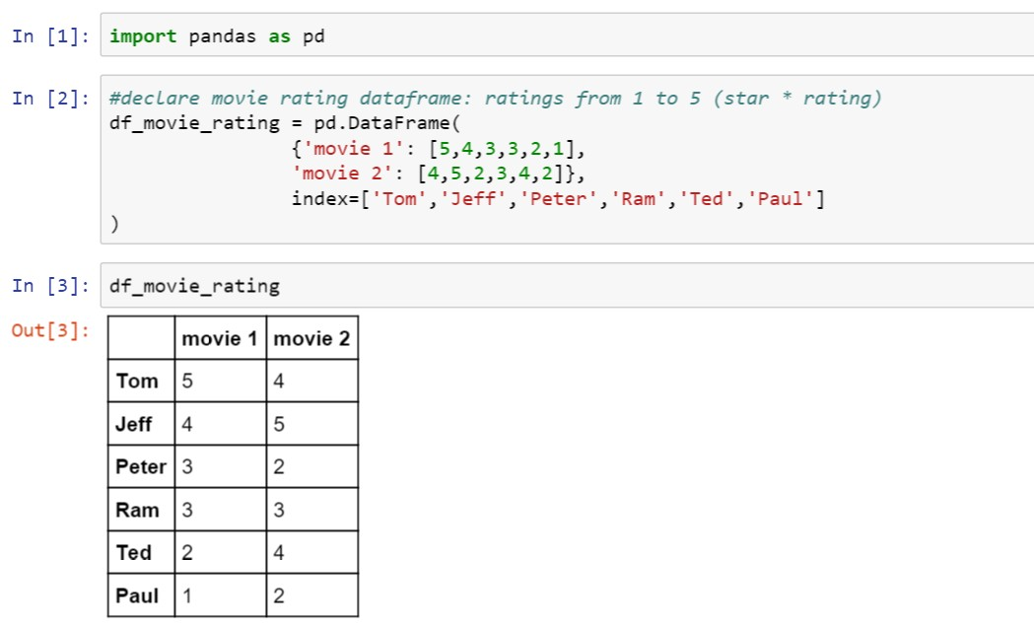
Data Operation
Data operation can be performed through various built -in methods for faster data processing.

Slide 32
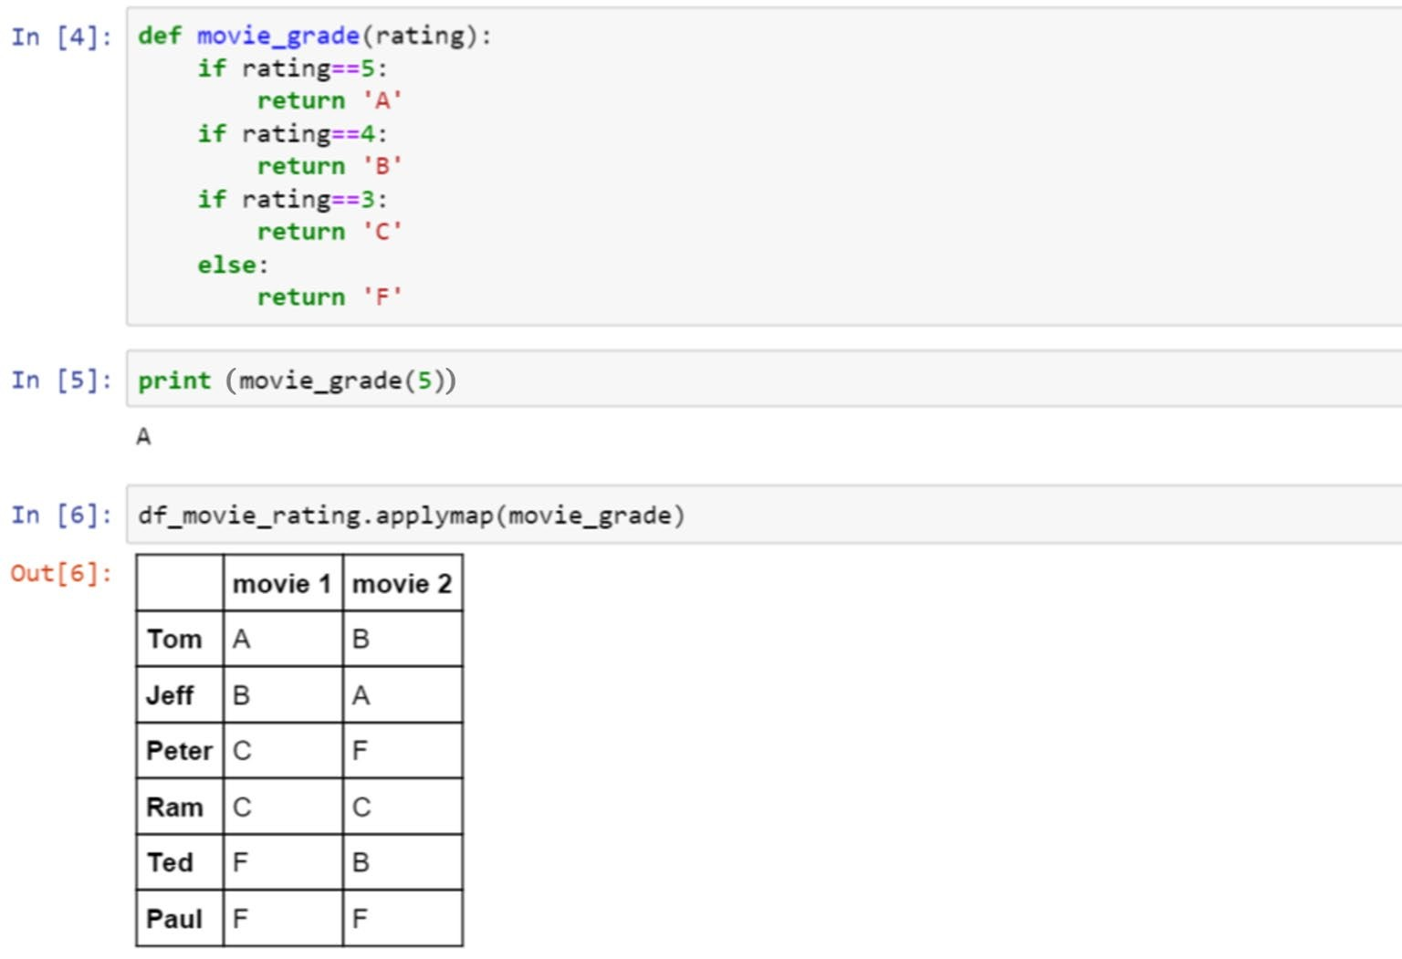
Data Operation with Functions
While performing data operation, custom functions can be applied using the applymap method.
Declare a custom function
Test the function
Apply the function to the DataFrame

Slide 33
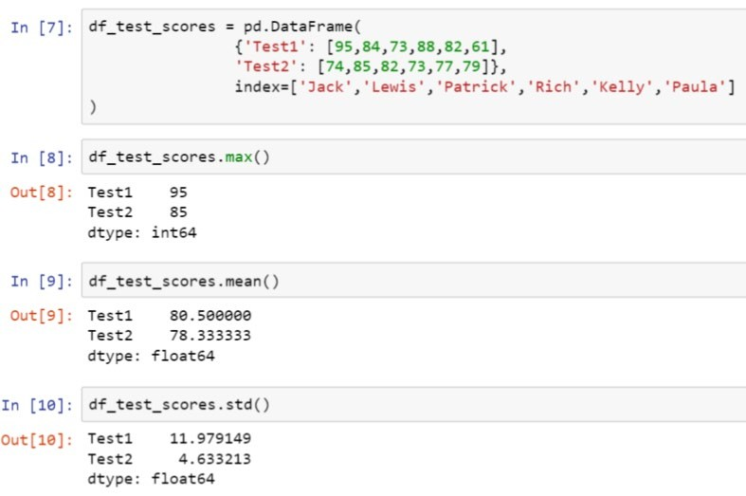
Data Operation with Statistical Functions
Create a DataFrame with two test
Apply the max function to find the maximum score
Apply the mean function to find the average score
Apply the std function to find the standard deviation for both the tests

Slide 34
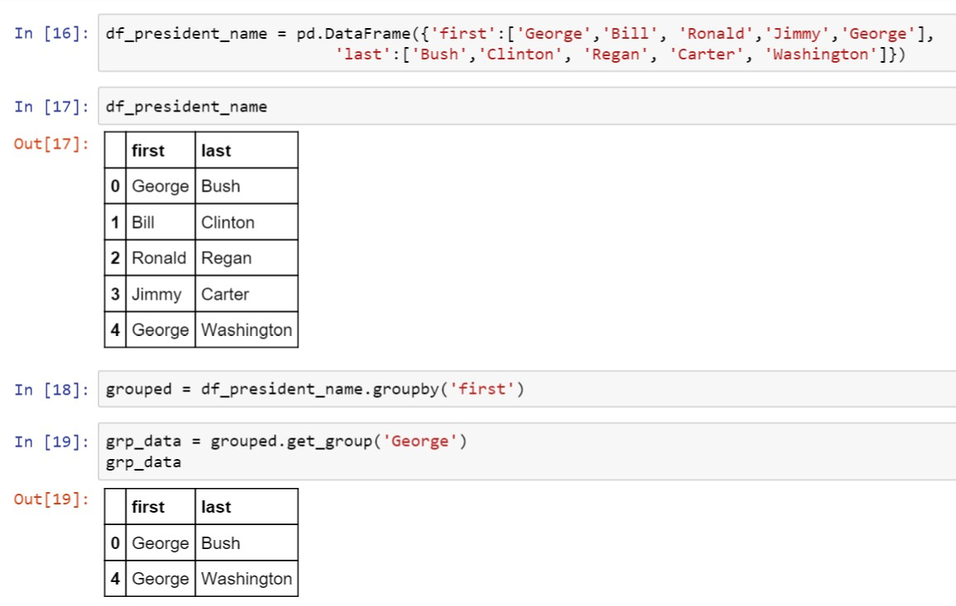

Data Operation Using Groupby
Create a DataFrame with first and last name as former presidents
Group the DataFrame with the first name
Group the DataFrame with the first name

Slide 35
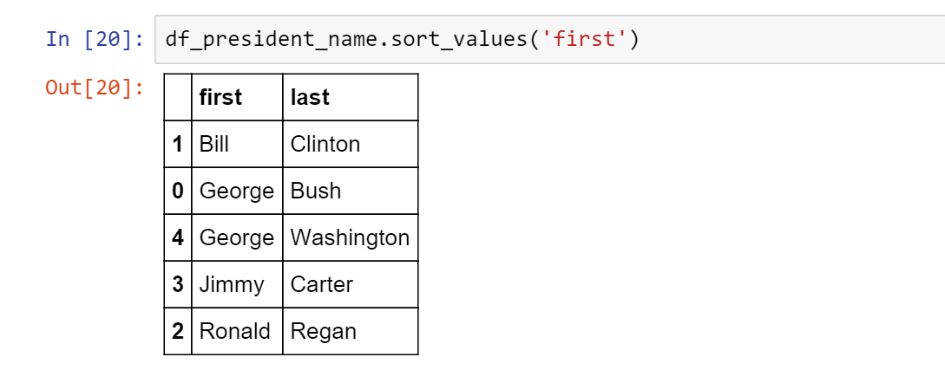
Data Operation Using Sorting
Sort values by first name

Slide 36
Data Operations
Problem Statement: Demonstrate how to perform data operations
Access: Click on the Practice Labs tab on the left side panel of the LMS. Copy or note the username and password that is generated. Click on the Launch Lab button. On the page that appears, enter the username and password in the respective fields, and click Login .

Slide 37
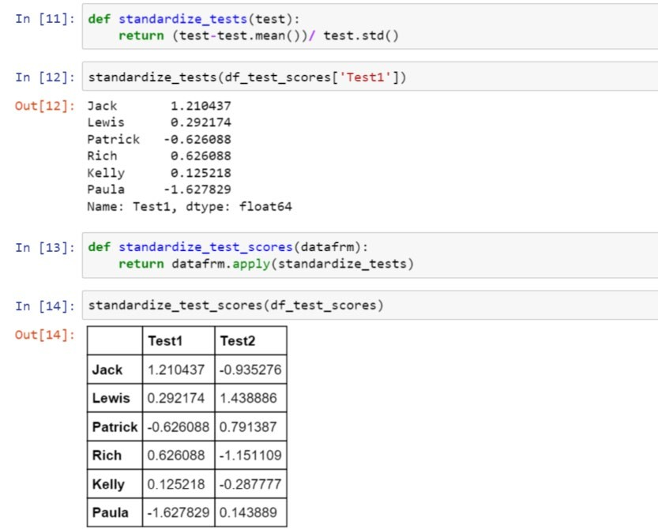
Data Standardization
Create a function to return the standardize value
Apply the function to the entire dataset
Standardized test data is applied for the entire DataFrame

Slide 38

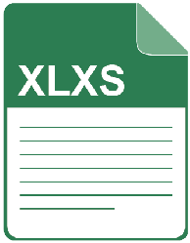

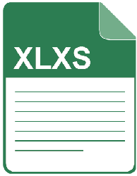





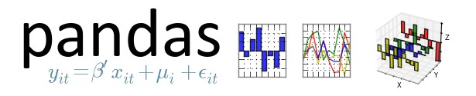




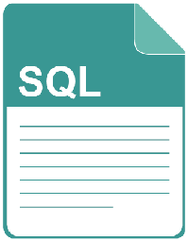
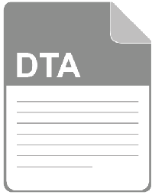
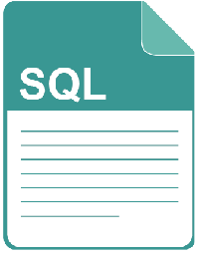
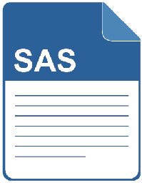
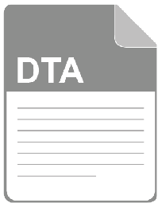

File Read and Write Support
read_excel to_excel
read_hdf to_hdf
read_clipboard to_clipboard
read_csv to csv
read_html to_html
read_json to_json
read_pickle to_pickle
read_sql to_sql
read_sas to sas
read_stata to_stata

Slide 39
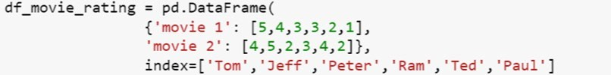
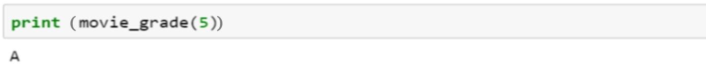
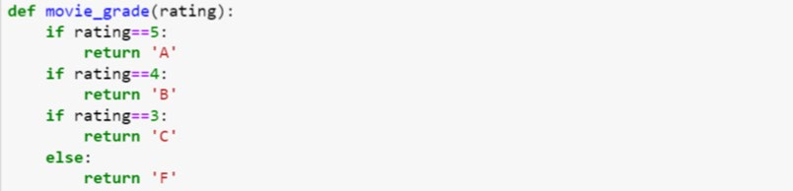
Activity: Sequence it Right!
The code here is buggy. You have to correct its sequence to debug it. To do that, click any two code snippets, which you feel are out of place, to swap their places.
1
2
3
4
Click any two code snippets to swap them.

Slide 40
Activity: Sequence it Right!
The code here is buggy. You must correct its sequence to debug it. To do that, click any two code snippets, which you feel are out of place, to swap their places.
1
3
2
4
Click any two code snippets to swap them.

Slide 41
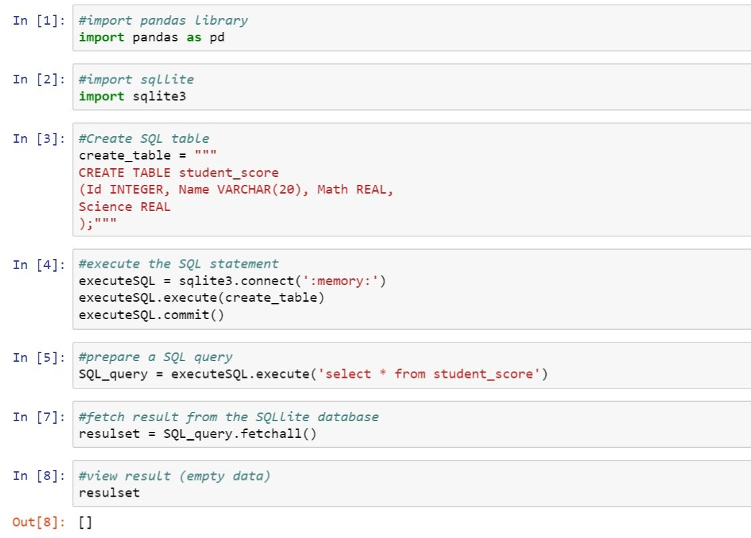
Pandas SQL Operation

Slide 42
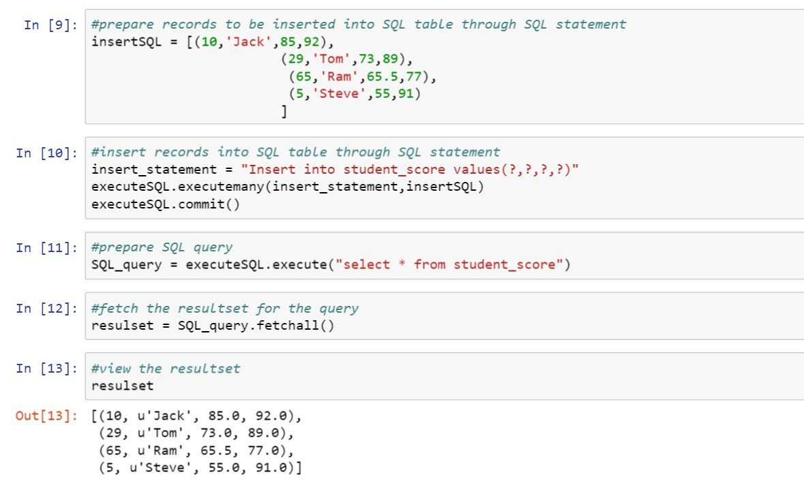
Pandas SQL Operation

Slide 43
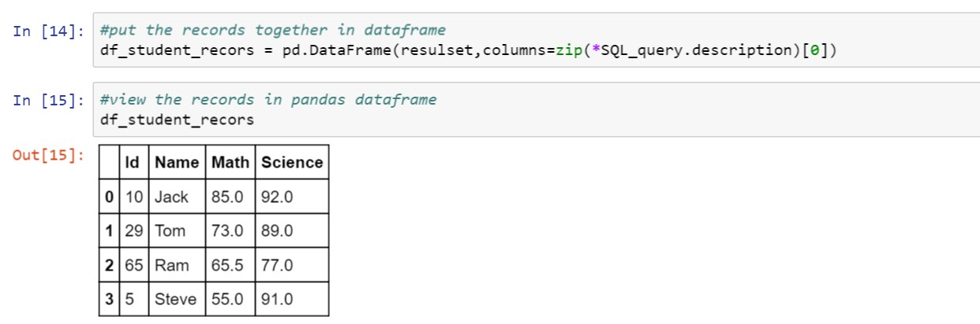
Pandas SQL Operation

Slide 44
Analyze the Federal Aviation Authority (FAA) Dataset using Pandas
Problem Statement:
Analyze the Federal Aviation Authority (FAA) dataset using Pandas to do the following:
1.View
Aircraft manufacturer name
State name
Aircraft model name
Text information
Flight phase
Event description type
Fatal flag
Clean the dataset and replace the fatal flag NaN with “No”
Find the aircraft types and their occurrences in the dataset
Remove all the observations where aircraft names are not available
Display the observations where fatal flag is “Yes”

Slide 45
Analyze the Federal Aviation Authority (FAA) Dataset using Pandas
Instructions to perform the assignment:
Download the FAA dataset from the “Resource” tab. Upload the dataset to your Jupyter notebook to view and evaluate it.
Common instructions:
If you are new to Python, download the “Anaconda Installation Instructions” document from the “Resources” tab to view the steps for installing Anaconda and the Jupyter notebook.
Download the “Assignment 01” notebook and upload it on the Jupyter notebook to access it.
Follow the cues provided to complete the assignment.

Slide 46
Analyzing the Dataset
Problem Statement:
A dataset in CSV format is given for the Fire Department of the New York City. Analyze the dataset to determine:
1.
2.
3.
The total number of fire department facilities in the New York city The number of fire department facilities in each borough
The facility names in Manhattan

Slide 47
Analyzing the Dataset
Instructions to perform the assignment:
Download the FDNY dataset from the “Resource” tab. You can upload the dataset to your Jupyter notebook to use it.
Common instructions:
If you are new to Python, download the “Anaconda Installation Instructions” document from the “Resources” tab to view the steps for installing Anaconda and the Jupyter notebook.
Download the “Assignment 02” notebook and upload it on the Jupyter notebook to access it.
Follow the cues provided to complete the assignment.

Slide 48
Key Takeaways
You are now able to:
Explain Pandas and its features
List different data structures of Pandas
Outline the process to create series and DataFrame with data inputs Explain how to view, select, and access elements in a data structure
Describe the procedure to handle vectorized operations Illustrate how to handle missing values
Analyze data with different data operation methods

Slide 49
How is an index for data elements assigned while creating a Pandas series ? Select all that apply?
a.
Created autom atica lly
b.
Needs to be assigned
c.
Once created can not be changed or altered
d.
In dex is not applica ble as series is one-dim ensio nal

Slide 50
How is an index for data elements assigned while creating a Pandas series ? Select all that apply?
a .
Created autom atica lly
b.
Needs to be assigned
c.
Once created can not be changed or altered
d.
In dex is not applica ble as series is one-dim ensio nal
The correct answer is
a, b
Data alignment is intrinsic in Pandas data structure and happens automatically. One can also assign index to data elements.

Slide 51
What will the result be in vector addition if label is not found in a series?
a.
Marked as zeros for m issin g labels
b.
La be ls will be skip ped
c.
Marked as Na N for m issing labels
d.
Will prom pt an exception, index not found

Slide 52
What will the result be in vector addition if label is not found in a series?
a .
Marked as zeros for m issin g labels
b.
La be ls will be skip ped
c.
Marked as Na N for m issing labels
d.
Will prom pt an exception, index not found
The correct answer is
c
The result will be marked as NaN (Not a Number) for missing labels.

Slide 53
What is the result of DataFrame[3:9]?
a.
Series with slice d in dex from 3 to 9
b.
dict of index positio ns 3 and 9
c.
Data Fram e of sliced rows index from 3 to 9
d.
Data Fram e with data e lem ents at index 3 to 9

Slide 54
What is the result of DataFrame[3:9]?
a .
Series with slice d in dex from 3 to 9
b.
dict of index positio ns 3 and 9
c.
Data Fram e of sliced rows index from 3 to 9
d.
Data Fram e with data e lem ents at index 3 to 9
The correct answer is
c
This is DataFrame slicing technique with indexing or selection on data elements. When a user passes the range 3:9, the entire range from 3 to 9 gets sliced and displayed as output.

Slide 55
What does the fillna() method do?
a. Fills all Na N values with zeros
b.
Fills all Na N values with one
c.
Fills all Na N values with va lu es m entio ned in the parenthesis
d.
Drops NaN values from the dataset

Slide 56
What does the fillna() method do?
a . Fills all Na N values with zeros
b.
Fills all Na N values with one
c.
Fills all Na N values with va lu es m entio ned in the parenthesis
d.
Drops NaN values from the dataset
The correct answer is
c
fillna is one of the basic methods to fill NaN values in a dataset with a desired value by passing that in parenthesis.

Slide 57
Which of the following data structures is used to store three
-dimensional data?
a. Series
b.
Data Fram e
c.
Panel
d.
Pane lND

Slide 58
Which of the following data structures is used to store three
-dimensional data?
a . Series
b.
Data Fram e
c.
Panel
d.
Pane lND
The correct answer is
c
Panel is a data structure used to store three
-dimensional data.

Slide 59
Which method is used for label
-location indexing by label?
a.
ia t
b.
ilo c
c.
loc
d.
std

Slide 60
Which method is used for label
-location indexing by label?
a .
ia t
b.
ilo c
c.
loc
d.
std
The correct answer is
c
The loc method is used for label -location indexing by label; iat is strictly integer location and iloc is integer location -based indexing by position.
-

Slide 61
While viewing a dataframe, head() method will .
a.
return only the first row
b.
re turn on ly headers or colum n nam e of the Data Fram e
c.
return the first five rows of the Data Fram e
d.
throw an exception as it expects param eter(num ber) in parenthesis

Slide 62
While viewing a dataframe, head() method will .
a .
return only the first row
b.
re turn on ly headers or colum n nam e of the Data Fram e
c.
return the first five rows of the Data Fram e
d.
throw an exception as it expects param eter(num ber) in parenthesis
The correct answer is
c
The default value is 5 if nothing is passed in head method. So, it will return the first five rows of the DataFrame.

